Slide 1
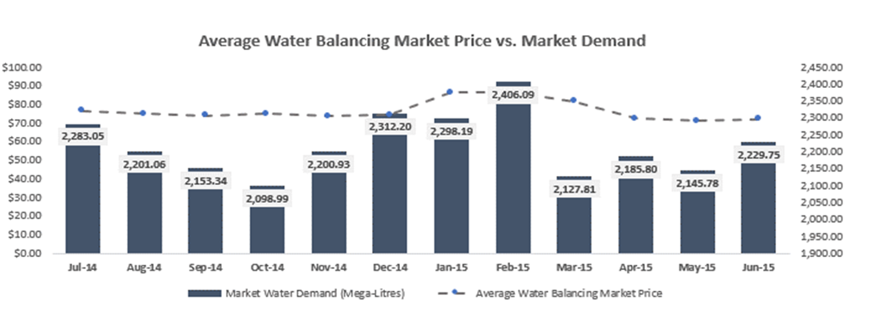
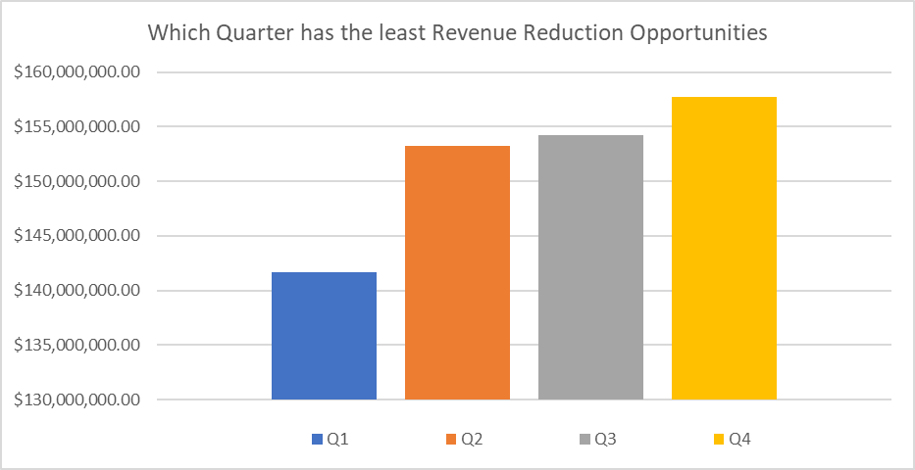
With an estimated 22% reduction in Surjek’s Revenues ($44 M) due to the Maintenance Outage, Quarter 4 presents the best balance of revenue-loss mitigation with respect to market pricing, as opposed to Quarter 1 which represents the highest demand (2273.07 GL) and Water Balancing Market Prices ($84.84).

Slide 2
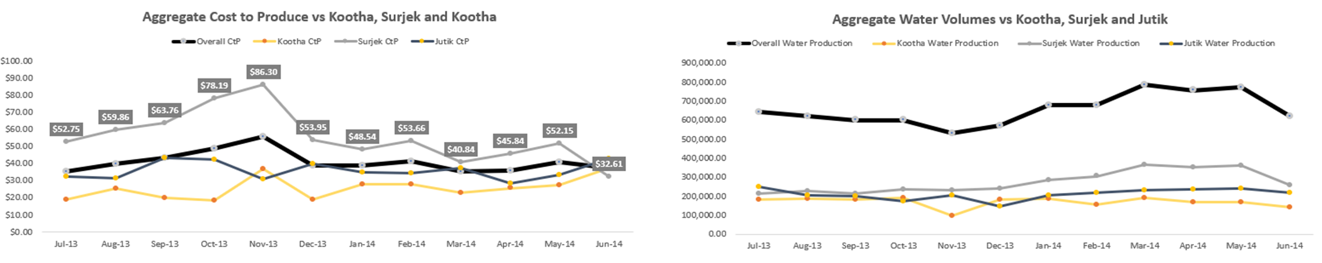
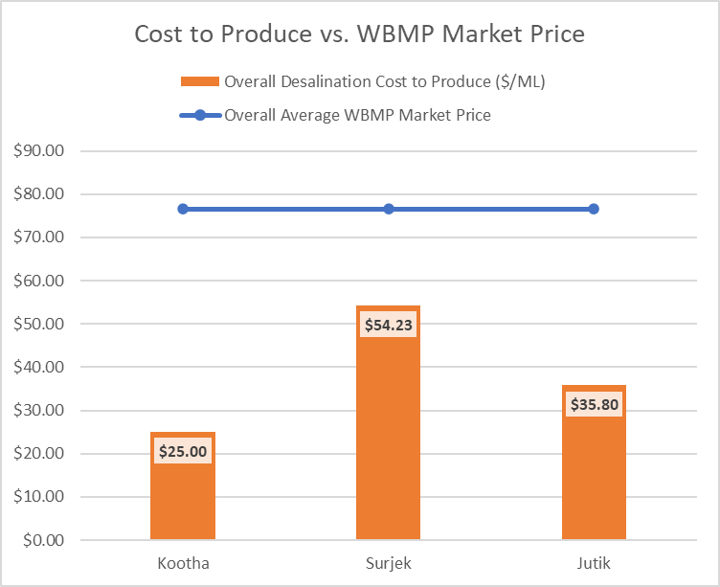
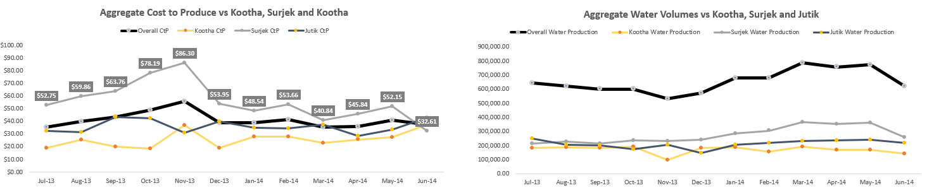
Of the three Desalination Plants, all three remain profitable at current market prices by a favorable margin; Clearly Kootha is the most cost-effective $25/ML) followed by Jutik ($35.80/ML) and lastly Surjek ($54.23/ML) which is consistent across the July-2013 to June-2014 period.

Slide 3
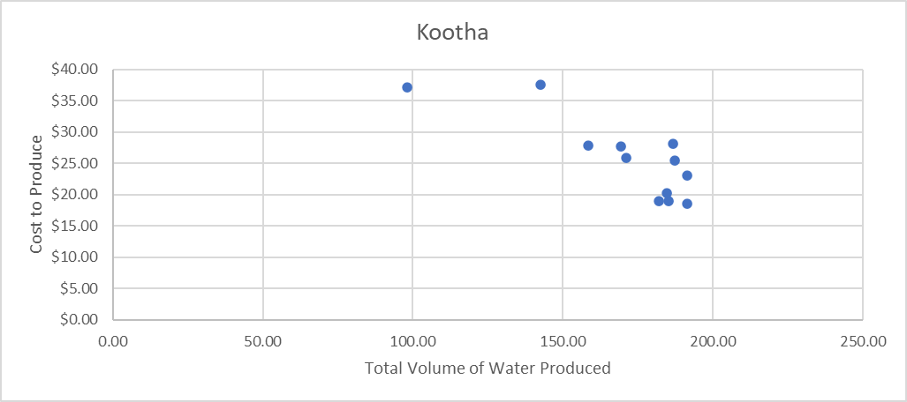
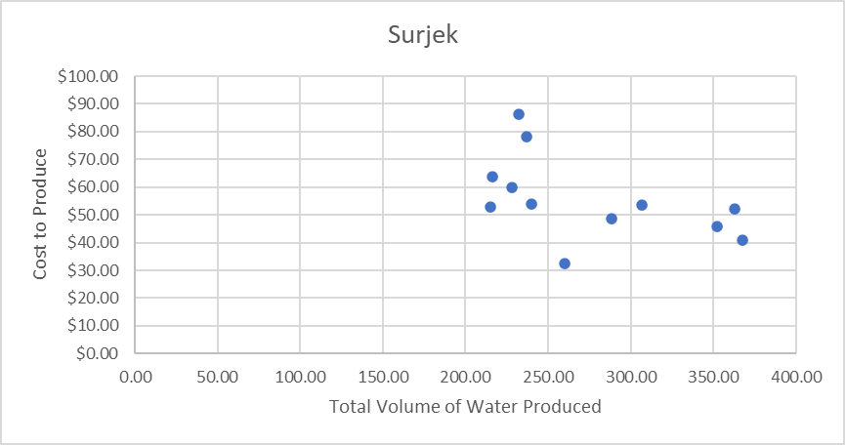
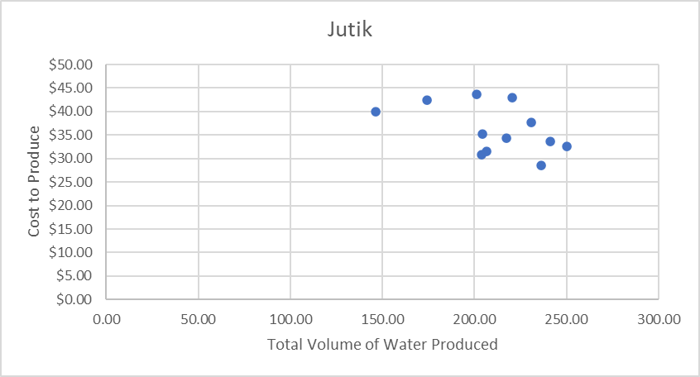
Contrasting the Cost to Produce against the Volume of Water Produced highlights clear economies of scale with costs rapidly dwindling across all plants as volume surges, with this being particularly noticeable across the Kootha and Surjek Plants with costs dropping as much as 50%.

Slide 4
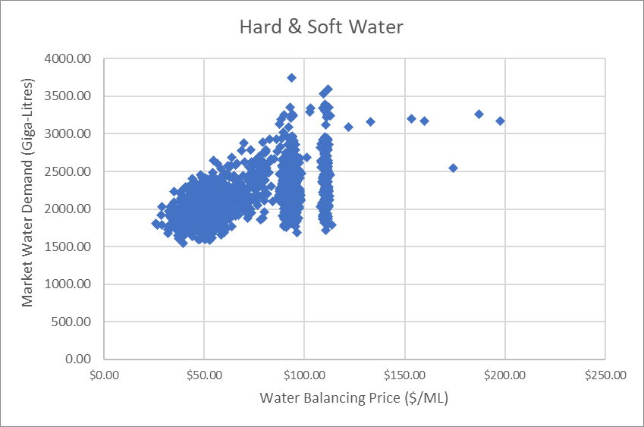
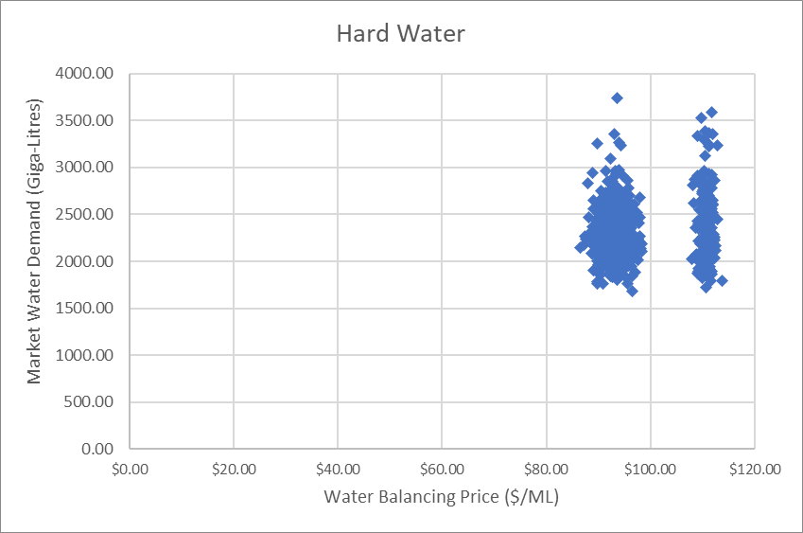
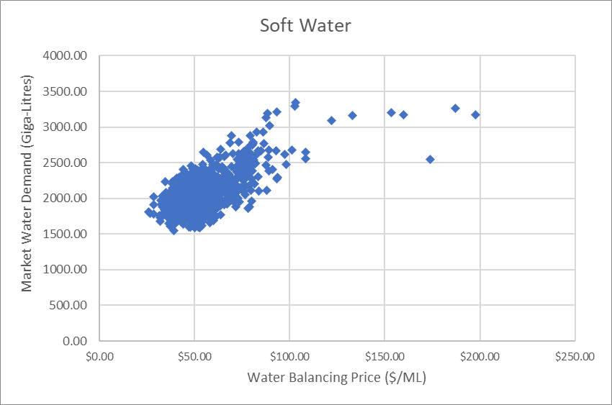
Drilling down further from a product perspective reveals two different patterns of elasticity where Soft Water tends to be relatively price inelastic with an average EoD of 0.92, while Hard Water is more representative of an elastic relationship with an average EoD of 41.49.

